Slide 1
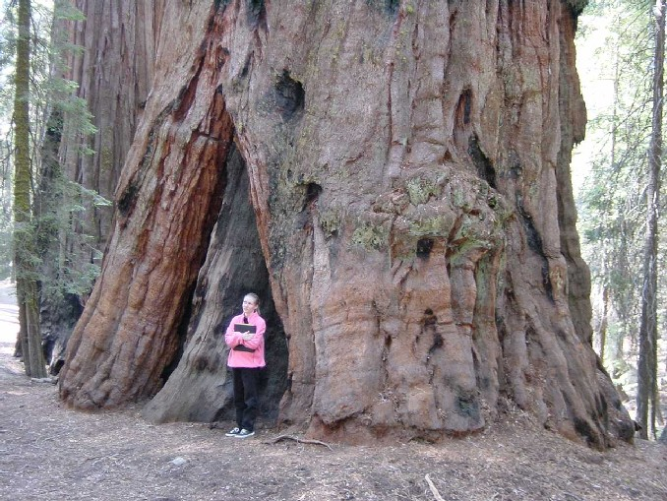
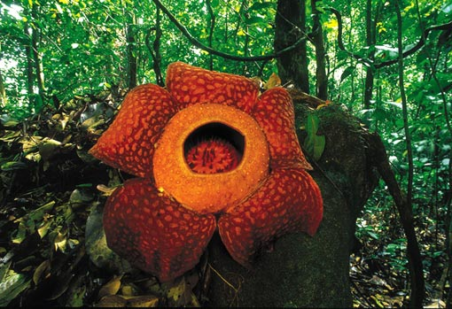
The Rainforest

Slide 2
Anna Mae & ENAM

Slide 3
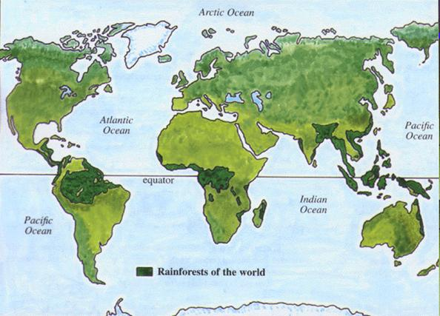
The rainforest is a tropical place located around the middle of the earth by the equator. The rainforest has many plants and animals. It rains there every day and there are many beautiful flowers.

Slide 4
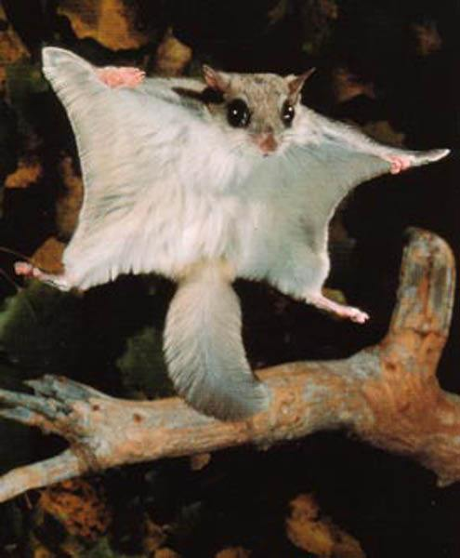
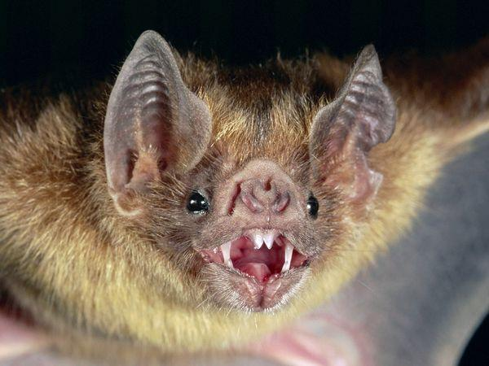
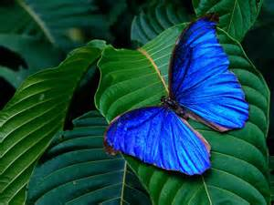
The rainforest has many animals like the blue morpho butterfly. This animal is endangered. The next animal we want to mention is the vampire bat .It really sucks animals blood. Now we will talk about the flying squirrel. It glides!

Slide 5
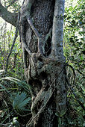
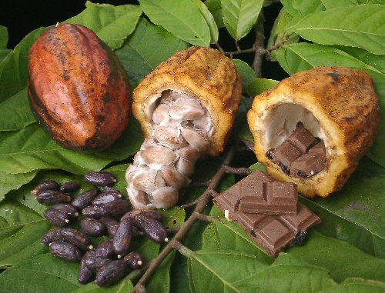
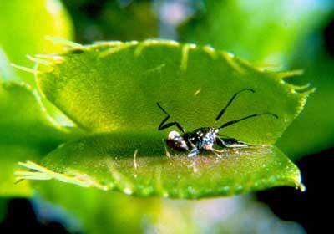
Many, many plants grow in the rainforest. The strangler fig tree has a face! The cocoa tree has chocolate pods. The Venus fly trap plant is a carnivore that eats bugs.

Slide 6
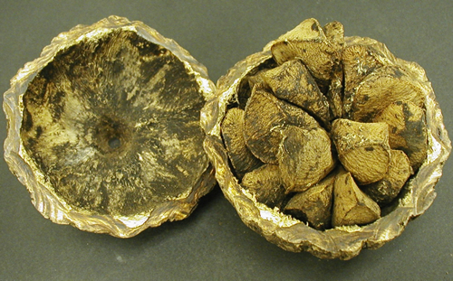
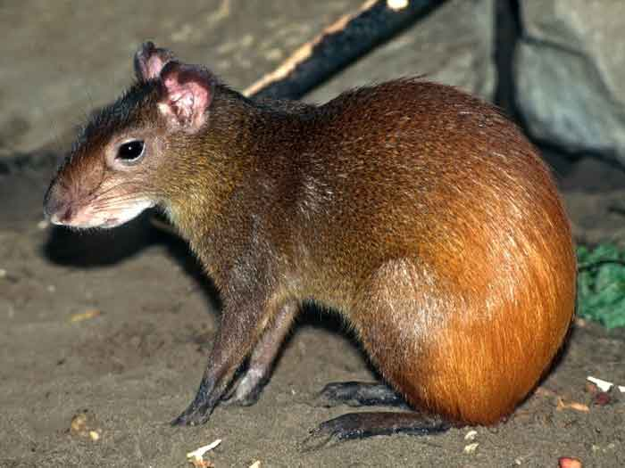
The agouti is a small, squirrel like animal with sharp teeth and without a tail. The agouti is the only animal that can crack a brazil nut seed pod open.

Slide 7
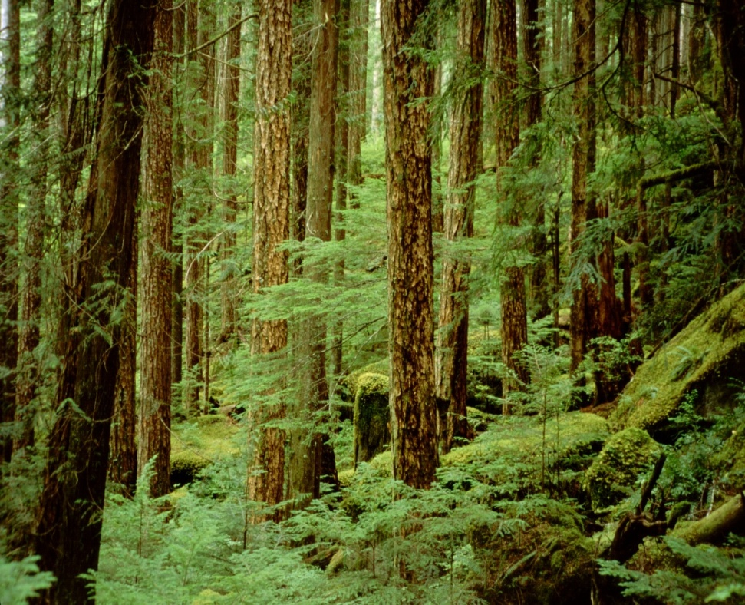
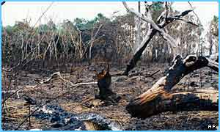
It does not eat all the nuts, but buries some of them for later.
In this way it is spreading the tree seeds all over the rainforest.
The rainforest is beautiful and we enjoyed learning about it.
People really need to save it and stop cutting it down!

