Slide 1
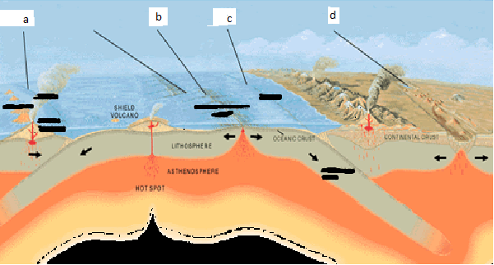
What type of boundary is a?
What is a process that happens at a?
What is a feature that happens at a?
Convergent (oc-oc)
Volcanism, subduction, earthquakes
Vocanos, trenches, islands

Slide 2
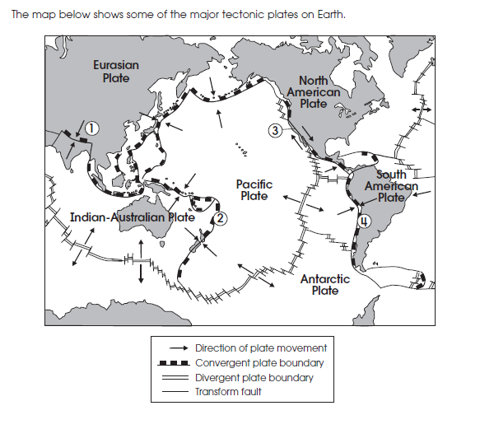
What is made at the star?
Could be more that one:
Mid Ocean Ridge
Ocean trenches
Fold Mountains
Islands
Volcanos

Slide 3
Which theory does this describe?
Used proof from mountain ranges across different
continents that match up to support the theory.
Theory of Continental Drift

Slide 4
What is happening at the star?
Subduction
Sea Floor Spreading
Earthquakes only
Mountain Building

Slide 5
Which theory does this describe?
Used proof fossils of the same animals on different continents to support the theory.
Theory of Continental Drift

Slide 6
What is happening at the star?
Subduction
Sea Floor Spreading
Earthquakes only
Mountain Building

Slide 7
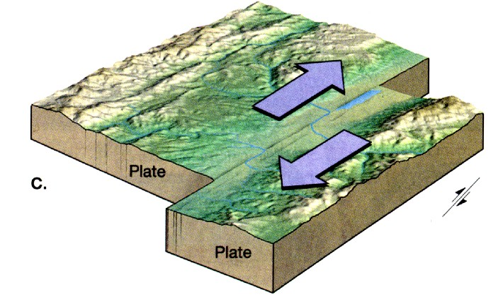
What type of boundary is shown above?
What is a process that happens at this boundary?
What is a feature that happens at this boundary?
Transform
Earthquakes Only
None

Slide 8
What is made at the star?
Could be more that one:
Mid Ocean Ridge
Ocean trenches
Fold Mountains
Islands
Volcanos

Slide 9
What type of boundary is d?
What is a process that happens at d?
What is a feature that happens at d?
Divergent (continental-continental)
Rifting, earthquakes
Rift valleys

Slide 10
What is happening at the star?
Subduction
Sea Floor Spreading
Earthquakes only
Mountain Building

Slide 11
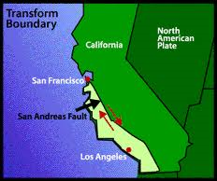
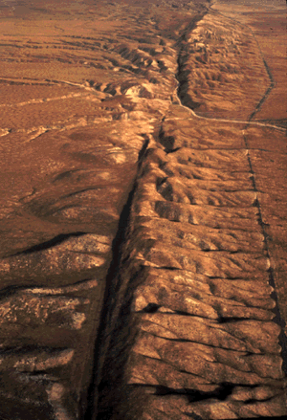
What will happen in the future?
The San Andreas Fault is a transform
boundary in California. How will it change
in the future?
A. A wider deeper valley will form.
B. High fold mountains will form.
C. Only more earthquakes as plates move side
by side.
D. The plate will become smaller as crust is
destroyed.

Slide 12
Which theory does this describe?
Stated that new sea floor is created at the Mid Ocean Ridge and recycled at trenches.
Theory of Sea Floor Spreading

Slide 13
What is happening at the star?
Subduction
Sea Floor Spreading
Earthquakes only
Mountain Building

Slide 14
Which theory does this describe?
Found the crust nearest to the Mid Ocean Ridge is the youngest.
Theory of Sea Floor Spreading

Slide 15
What is happening at the star?
Subduction
Sea Floor Spreading
Earthquakes only
Mountain Building

Slide 16
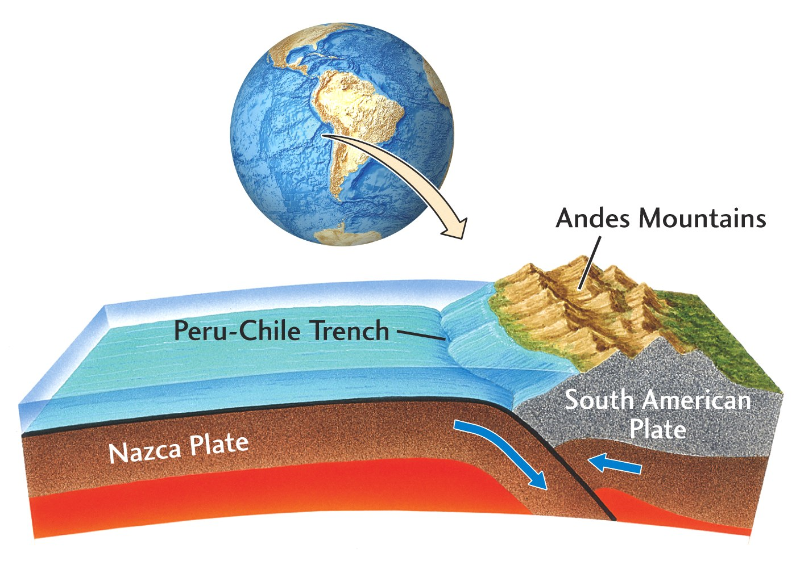
What will happen in the future?
The Andes mountains are at a convergent
(oceanic-continental) boundary. What will
they look like in the future?
A. A wider deeper valley will form.
B. More volcanic mountains will form.
C. Only more earthquakes as plates move side by side.
D. The plate will become larger as new crust is made.

Slide 17
What is happening at the star?
Subduction
Sea Floor Spreading
Earthquakes only
Mountain Building

Slide 18
Which theory does this describe?
Found that there are strips of crust on either side of the Mid Ocean Ridge that show the history of reversals of the Earth’s magnetic field.
Theory of Sea Floor Spreading

Slide 19
What is made at the star?
Could be more that one:
Mid Ocean Ridge
Ocean trenches
Fold Mountains
Islands
Volcanos

Slide 20
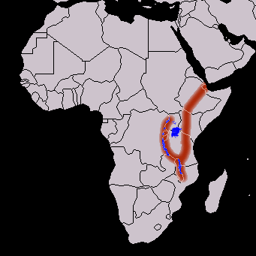
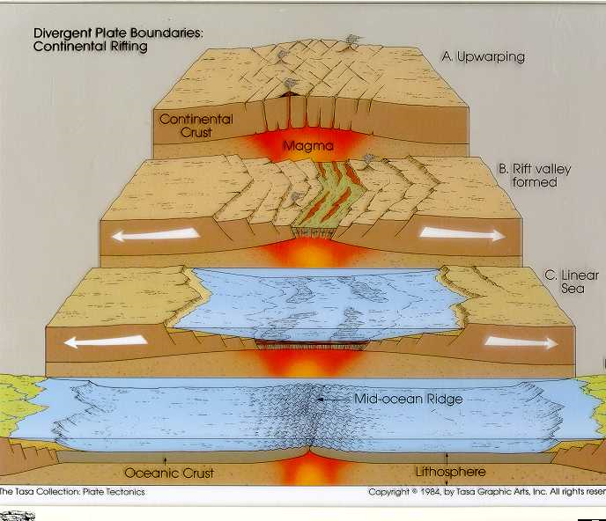
What will happen in the future?
The African Rift Valley is a divergent boundary
In Africa. What will it look like in the future?
A. A wider deeper valley will form.
B. Higher fold mountains will form.
C. Only more earthquakes as plates move side
by side.
D. The plate will become smaller as crust is
destroyed.

Slide 21
What is made at the star?
Could be more that one:
Mid Ocean Ridge
Ocean trenches
Fold Mountains
Islands
Volcanos

Slide 22
What type of boundary is b?
What is a process that happens at b?
What is a feature that happens at b?
Divergent (oceanic-oceanic)
Earthquakes, sea floor spreading, volcanism
Mid Ocean Ridge, volcanos

Slide 23
What is made at the star?
Could be more that one:
Mid Ocean Ridge
Ocean trenches
Fold Mountains
Islands
Volcanos

Slide 24
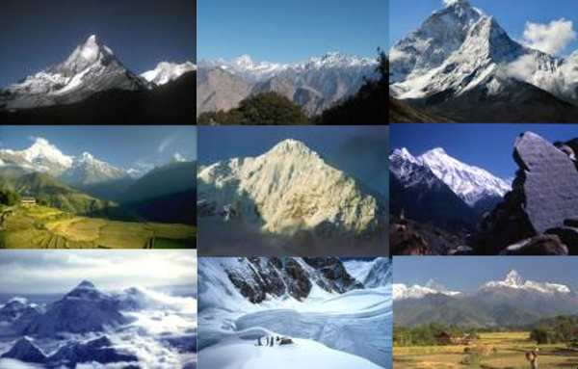
What will happen in the future?
The Himalayan Mountains are at a convergent
plate boundary in Asia. What will they look like
in the future?
A. A wider deeper valley will form.
B. Higher fold mountains will form.
C. Only more earthquakes as plates move side
by side.
D. The plate will become smaller as crust is
destroyed.

Slide 25
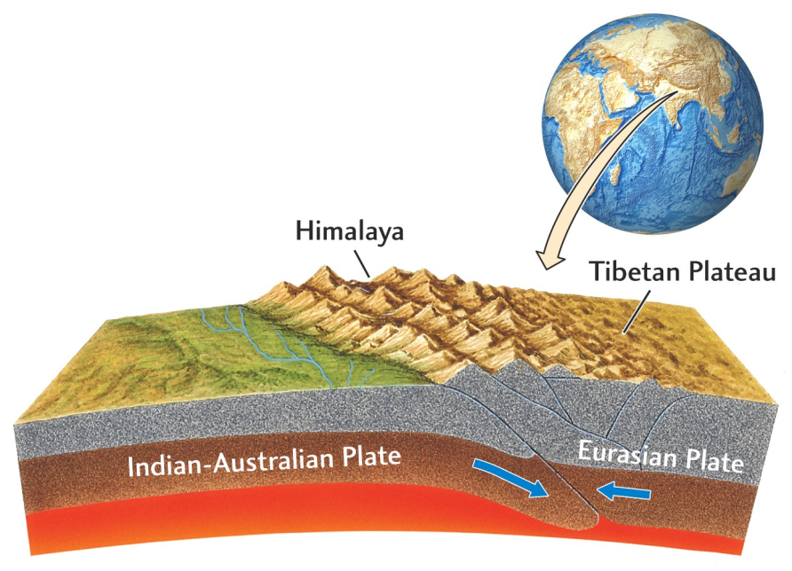
What type of boundary is shown above?
What is a process that happens at this boundary?
What is a feature that happens at this boundary?
Convergent(continental-continental)
Earthquakes, mountain building
Mountains

Slide 26
What type of boundary is c?
What is a process that happens at c?
What is a feature that happens at c?
Convergent (oceanic-continental)
Subduction, volcanism, earthquakes
Volcanos, trenches

Slide 27
Which theory does this describe?
The main failing of this theory is that it could not explain how the continents moved.
Theory of Continental Drift

Slide 28
What is happening at the star?
Subduction
Sea Floor Spreading
Earthquakes only
Mountain Building

